Slide 1

Browser game: Tetris
Flavio Medina
Philipp Prica
Benno Vuong

Slide 2

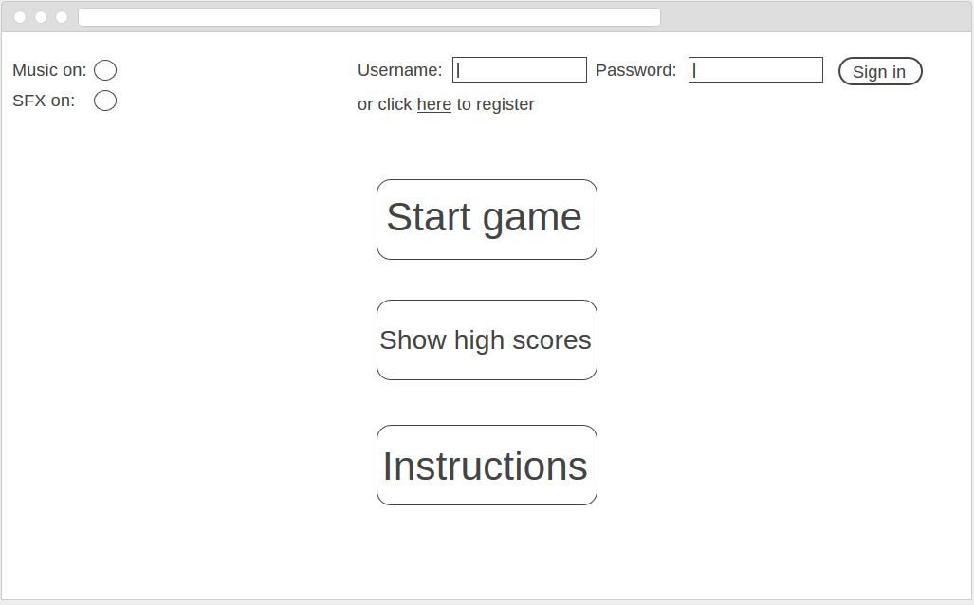
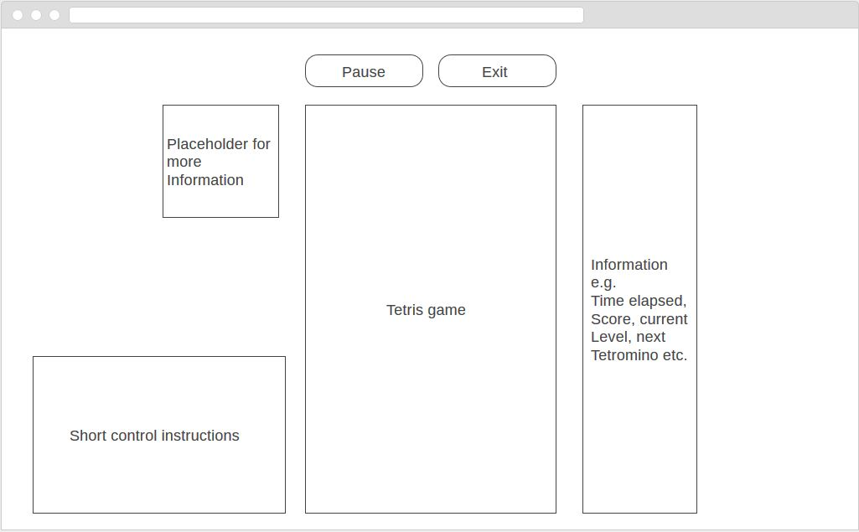
Simple wireframe

Slide 3






Technologies
Front end
Back end

Slide 4

User Stories
As a user, I want to
Play a game of Tetris
Be able to login and logoff
Save my scores and compare them to other high scores in a database
Change the difficulty of the game
Play against another person (Local Multiplayer)

